Slide 1
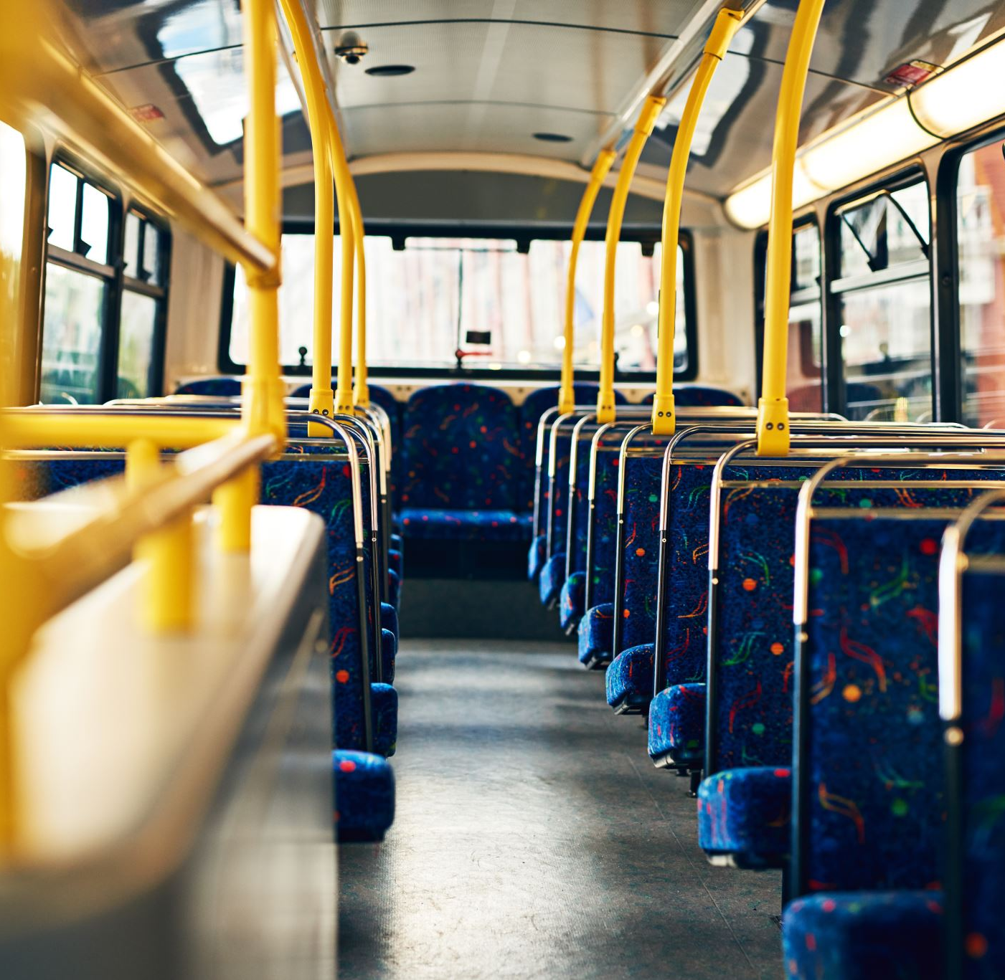
Boston Cambridge Public Transit
EMGT 5220 Fall 2021 Rochana Dudwadkar

Slide 2
Why public transit?
Q1. How far do you travel to get to college or work?
- Less than 1 mile= 25%
- Less than 5 miles= 40%
Less than 10 miles= 35%
Q2. Which transportation do you use to travel to college or work?
Subway= 77%; Car= 20%; Uber= 3%
Q3. Do you consider public transport as a cheaper and safer option to travel?
- Yes= 90%; No= 10%

Slide 3
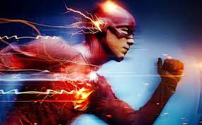
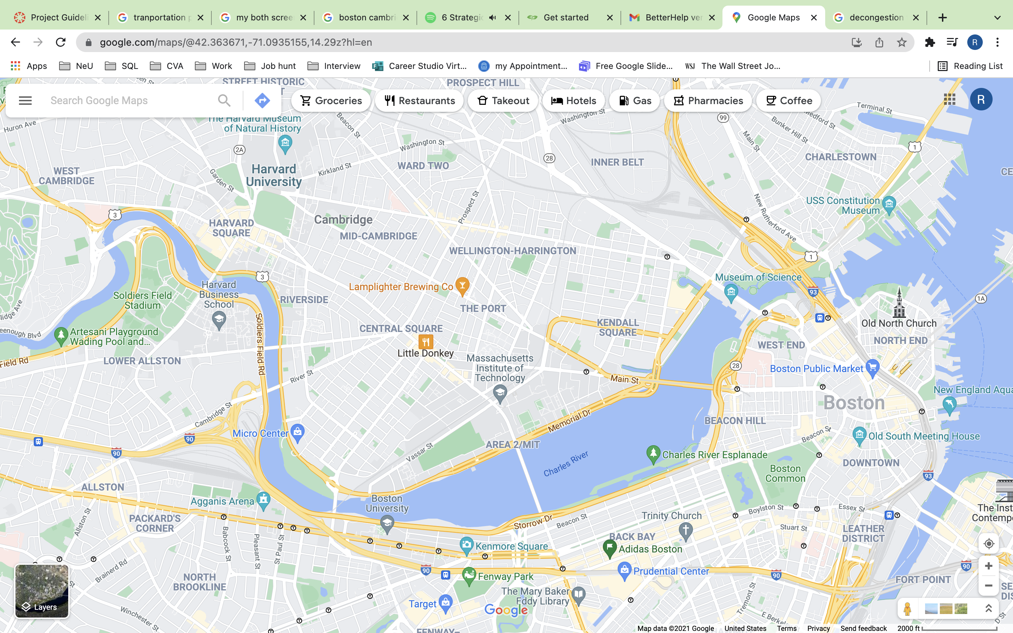


Objectives
Decongestion of city traffic
Less pollution
Cheaper Transit
Connect two major educational cities

Slide 4
Scope
Conduct feasibility tests
Design railway route over street and underground
Construction of stations, bridges, tunnels
Pilot testing

Slide 5


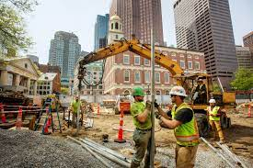
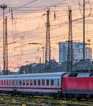
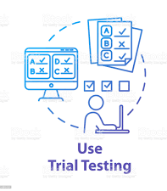

Project Plan
Planning and Design
Finalize Contract
Start Construction
Power Distribution and Signaling
Testing
Launch

Slide 6
Thank You!
For any questions email dudwadkar.r@northeastern.edu

